Slide 1

Generatieve AI
Tjorn Brederoo

Slide 2

Het onderzoek
Zoektermen en plekken
Soorten generatieve AI
Toepassingen en impact
Mening

Slide 3
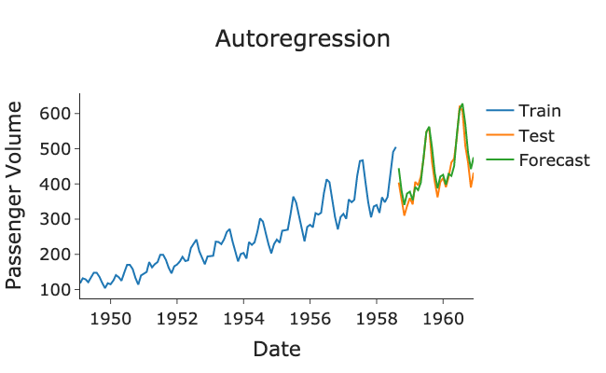
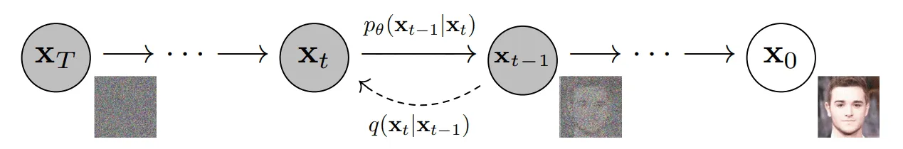
Diffusion en Autoregressie
Diffusion: noise
Autoregressie: voorspellen
Toepassingen

Slide 4

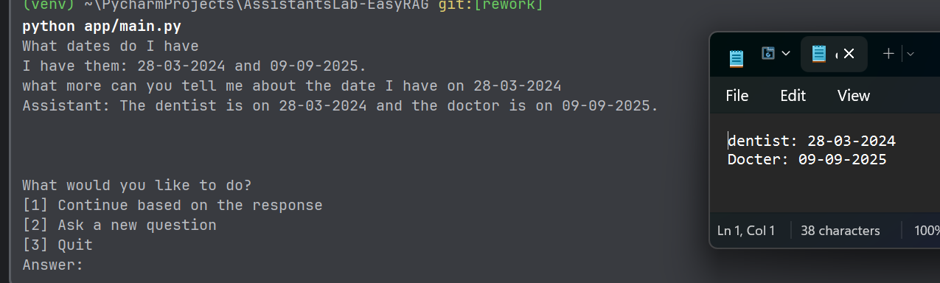
Demo
Rag
EasyRag

Slide 5

Hoofd bronnen
AssistantsLab
Amazon
Google
OpenAI
Nvidia
Medium

Slide 6
Bronnen onderzoek
Harvard. (2023, 19 april). The Benefits and Limitations of Generative AI: Harvard Experts Answer Your Questions. Harvard Online. Geraadpleegd op 25 maart 2024, van https://www.harvardonline.harvard.edu/blog/benefits-limitations-generative-ai
Ahirwar, K. (2023, 19 oktober). A Very Short Introduction to Diffusion Models - Kailash Ahirwar - Medium. Medium. Geraadpleegd op 25 maart 2024, van https://kailashahirwar.medium.com/a-very-short-introduction-to-diffusion-models-a84235e4e9ae
Caulfield, J. (2023, 30 augustus). Wat is generative AI? | Betekenis & Voorbeelden. Scribbr. Geraadpleegd op 25 maart 2024, van https://www.scribbr.nl/ai-tools-gebruiken/generative-ai-uitgelegd/
Sajid, H. (2023, 31 maart). Diffusion Models in AI – Everything You Need to Know. Unite.AI. Geraadpleegd op 25 maart 2024, van https://www.unite.ai/diffusion-models-in-ai-everything-you-need-to-know/
Explained: generative AI. (2023, 9 november). MIT News | Massachusetts Institute Of Technology. Geraadpleegd op 25 maart 2024, van https://news.mit.edu/2023/explained-generative-ai-1109
DeepAI. (2020, 25 juni). Autoregessive model. DeepAI. Geraadpleegd op 25 maart 2024, van https://deepai.org/machine-learning-glossary-and-terms/autoregressive-model
Google. (z.d.). Overview of GAN Structure. Google For Developers. Geraadpleegd op 25 maart 2024, van https://developers.google.com/machine-learning/gan/gan_structure
Lynch, M. (2023, 1 juni). Generative AI with Variational Autoencoders - Morgan Lynch - Medium. Medium. Geraadpleegd op 25 maart 2024, van https://medium.com/@morgan_lynch/generative-ai-with-variational-autoencoders-86d1926df6e8
Kumawat, T. (2023, 16 mei). Deep Learning Part 6: Generative Modelling through Normalizing Flows. Medium. Geraadpleegd op 26 maart 2024, van https://medium.com/@tejpal.abhyuday/deep-learning-part-6-generative-modelling-through-normalizing-flows-c79fffc90091
OpenAI. (2018, 9 juli). Glow: Better reversible generative models. Geraadpleegd op 26 maart 2024, van https://openai.com/research/glow
Chatterjee, H. S. (2019, 16 juli). A Basic Introduction to Convolutional Neural Network. Medium. Geraadpleegd op 26 maart 2024, van https://medium.com/@himadrisankarchatterjee/a-basic-introduction-to-convolutional-neural-network-8e39019b27c4

Slide 7
Bronnen onderzoek
NVIDIA. (z.d.). Generative AI – What is it and How Does it Work? | NVIDIA. Geraadpleegd op 26 maart 2024, van https://www.nvidia.com/en-us/glossary/generative-ai/
Intel. (sd). What Is a GPU? Geraadpleegd op 26 maart 2024, van https://www.intel.com/: https://www.intel.com/content/www/us/en/products/docs/processors/what-is-a-gpu.html
Computer Hope. (2022, 18 oktober). Core. Geraadpleegd op 26 maart 2024, van https://www.computerhope.com/jargon/c/core.htm
Lee, K. C. (2020, 27 augustus). Parallel Computing — Upgrade Your Data Science with GPU Computing. Medium. Geraadpleegd op 26 maart 2024, van https://towardsdatascience.com/parallel-computing-upgrade-your-data-science-with-a-gpu-bba1cc007c24
Martindale, J. (2023, 2 september). What is a CPU? Here’s everything you need to know. Digital Trends. Geraadpleegd op 26 maart 2024, van https://www.digitaltrends.com/computing/what-is-a-cpu/
Team, T. (2021, 18 juli). CPU vs GPU in Machine Learning Algorithms: Which is Better? ThinkML. Geraadpleegd op 26 maart 2024, van https://thinkml.ai/cpu-vs-gpu-in-machine-learning-algorithms-which-is-better/
NVIDIA. (z.d.). Deep learning frameworks. NVIDIA Developer. Geraadpleegd op 27 maart 2024, van https://developer.nvidia.com/deep-learning-frameworks#:~:text=Deep%20learning%20(DL)%20frameworks%20offer,a%20high%2Dlevel%20programming%20interface.&text=This%20eliminates%20the%20need%20to,build%20DL%20frameworks%20from%20source.
Sharma, P. (2024, 25 januari). Exploring the Best Deep Learning Frameworks: A Comprehensive Guide for 2024. Analytics Vidhya. Geraadpleegd op 27 maart 2024, van https://www.analyticsvidhya.com/blog/2019/03/deep-learning-frameworks-comparison/
Stack Overflow. (2023, mei). 2023 Developer Survey. Geraadpleegd op 27 maart 2024, van https://survey.stackoverflow.co/2023/
Yegulalp, S. (2024, 5 januari). What is TensorFlow? The machine learning library explained. InfoWorld. Geraadpleegd op 27 maart 2024, van https://www.infoworld.com/article/3278008/what-is-tensorflow-the-machine-learning-library-explained.html
Gradescope | Save time grading. (z.d.). Geraadpleegd op 27 maart 2024, van
https://www.gradescope.com/
Introduction to TensorFlow. (z.d.). Geraadpleegd op 27 maart 2024, van
TensorFlow. https://www.tensorflow.org/learn
PyTorch | Meta Open Source. (z.d.). Geraadpleegd op 27 maart 2024, van
https://opensource.fb.com/projects/pytorch/

Slide 8
Bronnen onderzoek
Shetty, S. (2018, 20 september). What is PyTorch and how does it work? Packt Hub. Geraadpleegd op 27 maart 2024, van https://hub.packtpub.com/what-is-pytorch-and-how-does-it-work/
PyTorch. (z.d.). Get Started. Geraadpleegd op 27 maart 2024, van https://pytorch.org/get-started/
ChatGPT: Wat kan (en mag) er? - Universiteit Leiden. (z.d.). Search. https://www.bibliotheek.universiteitleiden.nl/studenten/chatgpt#ik-ben-student-do-s-and-dont-s,ik-ben-docent-hoe-ga-ik-om-met-het-gebruik-van-chatgpt
Risico’s van generatieve AI vereisen terughoudendheid in gebruik | Rathenau Instituut. (z.d.). https://www.rathenau.nl/nl/digitalisering/risicos-van-generatieve-ai-vereisen-terughoudendheid-gebruik#:~:text=Risico's%20van%20generatieve%20AI%20vereisen%20terughoudendheid%20in%20gebruik,-Artikel&text=terughoudendheid%20in%20gebruik-,De%20opkomst%20van%20generatieve%20AI%2Dsystemen%20versterkt%20bekende%20risico's%20van,intellectueel%20eigendom%20en%20menselijke%20ontwikkeling
Scribbr. (2023, 2 juni). How accurate are AI detectors? https://www.scribbr.com/frequently-asked-questions/how-accurate-are-ai-detectors/#:~:text=AI%20detectors%20work%20by%20looking,'t%20guarantee%20100%25%20accuracy
Donges, N., & Urwin, U. (2024, 28 februari). A Complete Guide to Recurrent Neural Networks (RNNs). Built In. https://builtin.com/data-science/recurrent-neural-networks-and-lstm
What is RAG? - Retrieval-Augmented Generation Explained - AWS. (z.d.). Amazon Web Services, Inc. https://aws.amazon.com/what-is/retrieval-augmented-generation/
Paruchuri, V. (2023, 20 maart). How does ChatGPT work? Dataquest. https://www.dataquest.io/blog/how-does-chatgpt-work/
Hamza, S. (2023, 2 juli). Why LLMs are consuming more memory than high end PC games? | Medium. Medium. https://medium.com/@syedhamzatahir1001/why-llms-are-consuming-more-memory-than-call-of-duty-warzone-42e56d570498
Lark Editorial Team. (2023, 25 december). Ai Accelerator. www.larksuite.com. Geraadpleegd op 27 maart 2024, van https://www.larksuite.com/en_us/topics/ai-glossary/ai-accelerator
Peru, G. (2023, 27 december). What is an NPU? Here’s why everyone’s suddenly talking about them. Digital Trends. https://www.digitaltrends.com/computing/what-is-npu/
Cloudflare. (z.d.). What is a vector database? Geraadpleegd op 28 maart 2024, van https://www.cloudflare.com/learning/ai/what-is-vector-database/

Slide 9
Bronnen onderzoek
Freda, A. (2022, 20 juni). Wat is RAM-geheugen en hoe werkt het? Wat Is RAM-geheugen en Hoe Werkt Het? https://www.avg.com/nl/signal/what-is-ram#:~:text=RAM%20staat%20voor%20Random%20Access,scherm%20naar%20de%20andere%20kant
Bijl, M. (2023, 13 september). Hoe werkt VRAM en hoeveel heb je er van nodig? ikbouwjepc.nl. https://www.ikbouwjepc.nl/post/hoe-werkt-vram-en-hoeveel-heb-je-er-van-nodig
Pinecone. (z.d.). Rerankers and Two-Stage Retrieval. Geraadpleegd op 28 maart 2024, van https://www.pinecone.io/learn/series/rag/rerankers/
Tensor Processing Units (TPUs). (z.d.). Google Cloud. Geraadpleegd op 28 maart 2024, van https://cloud.google.com/tpu
What are Autoregressive Models? - AR Models Explained - AWS. (z.d.). Amazon Web Services, Inc. Geraadpleegd op 28 maart 2024, van https://aws.amazon.com/what-is/autoregressive-models/
Adaloglou, S. K. . N. (2022, 29 september). How diffusion models work: the math from scratch | AI Summer. AI Summer. https://theaisummer.com/diffusion-models/
Acharya, A. (2024, 20 maart). An Introduction to Diffusion Models for Machine Learning. https://encord.com/blog/diffusion-models/#:~:text=Diffusion%20models%20are%20a%20class%20of%20generative%20models%20that%20simulate,a%20sequence%20of%20invertible%20operations.
Curry, R. (2023, 10 augustus). How A.I. can help create jobs for humans, not just automate them. CNBC. https://www.cnbc.com/2023/08/10/how-ai-can-help-create-jobs-for-humans-not-just-automate-them.html
Amazon. (z.d.). What is Linear Regression? - Linear Regression Explained - AWS. Amazon Web Services, Inc. Geraadpleegd op 28 maart 2024, van https://aws.amazon.com/what-is/linear-regression/
Radauskas, G. (2023, 29 maart). Swagged-out pope, arrested Trump, and other AI fakes. www.cybernews.com. Geraadpleegd op 28 maart 2024, van https://cybernews.com/news/ai-fake-photos-earthquake-oregon/
Van den Oord, A., Kalchbrenner, N., & Kavukcuoglu, K. (2016). Pixel recurrent neural networks. Arxiv, 1601.06759. https://doi.org/10.48550/arXiv.1601.06759
Kalliamvakou, E. (2023, 29 september). Research: quantifying GitHub Copilot’s impact on developer productivity and happiness - The GitHub Blog. The GitHub Blog. https://github.blog/2022-09-07-research-quantifying-github-copilots-impact-on-developer-productivity-and-happiness/

Slide 10
Bronnen onderzoek
Introducing Devin, the first AI software engineer. (2024). Geraadpleegd op 28 maart 2024, van https://www.cognition-labs.com/introducing-devin
Mac, R., & Grynbaum, M. M. (2023, 27 december). The Times sues OpenAI and Microsoft over A.I. use of copyrighted work. New York Times. Geraadpleegd op 28 maart 2024, van https://www.nytimes.com/2023/12/27/business/media/new-york-times-open-ai-microsoft-lawsuit.html
Klarna AI assistant handles two-thirds of customer service chats in its first month | Klarna International. (2024, 27 februari). Geraadpleegd op 28 maart 2024, van https://www.klarna.com/international/press/klarna-ai-assistant-handles-two-thirds-of-customer-service-chats-in-its-first-month/
Robson, D. (2022, 25 februari). Why we’re so terrified of the unknown. BBC. Geraadpleegd op 1 april 2024, van https://www.bbc.com/worklife/article/20211022-why-were-so-terrified-of-the-unknown
De, S. D., Smith, S. L. S., Botev, A. B., Christian-Muraru, G. C., Gu, A. G., Haroun, R. H., Berrada, L. B., Chen, Y. C., Srinivasan, S. S., Desjardins, G. D., Doucet, A. D., Budden, D. B., Whye Teh, Y. W. T., Pascanu, R. P., De Freitas, N. D. F., & Gulcehre, C. G. (2024). Griffin: Mixing gated linear recurrences with local attention for efficient language models. arXiv. Geraadpleegd op 11 april 2024, van https://doi.org/10.48550/arXiv.2402.19427
Common problems. (z.d.). Google For Developers. Geraadpleegd op 11 april 2024, van https://developers.google.com/machine-learning/gan/problems
Bloomberg - Are you a robot? (2023, 21 juni). Geraadpleegd op 11 april 2024, van https://www.bloomberg.com/news/articles/2023-06-21/what-s-the-h100-the-chip-driving-generative-ai-quicktake
Shilov, A. (2024, 2 februari). Nvidia’s H100 AI GPUs cost up to four times more than AMD’s competing MI300X — AMD’s chips cost $10 to $15K apiece;… Tom’s Hardware. Geraadpleegd op 11 april 2024, van https://www.tomshardware.com/tech-industry/artificial-intelligence/nvidias-h100-ai-gpus-cost-up-to-four-times-more-than-amds-competing-mi300x-amds-chips-cost-dollar10-to-dollar15k-apiece-nvidias-h100-has-peaked-beyond-dollar40000
Bradley, A. (2023, 14 augustus). What Is VRAM? Why Games Are Using it More, and How to Optimize Your PC. PCMAG. https://www.pcmag.com/how-to/what-is-vram-why-games-are-using-it-more-and-how-to-optimize-your-pc

